Slide 1
CSS display

Slide 2
Inline vs. Block Display (HTML)
All HTML elements (tags) are assigned a display property value of either inline or block.
Inline elements display in browsers horizontally.
[INLINE ELEMENT 1] [INLINE ELEMENT 2] [INLINE ELEMENT 3]
Block elements display in browsers vertically (stacked one on top of the other).
[BLOCK ELEMENT 1] [BLOCK ELEMENT 2] [BLOCK ELEMENT 3]
Examples of inline elements:
<a> <img> <strong> <em> <span>
Examples of block elements:
<p> <h1-h6> <div> <hr> <table> <ul> <ol>

Slide 3
Inline vs. Block Display (CSS)
Using CSS, you can change this inherent display property:
To force a block display, use the declaration display: block;
To force an inline display, use the declaration display: inline;
To force a list, use the declaration display: list-item;
To hide elements matching the selector, use the declaration display: none;

Slide 4
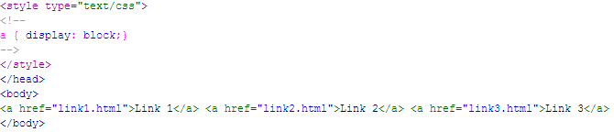

Example – display: block;
Normally, <a> tags display inline.
But, if you add the style a {display: block;}, they will display as a vertical navigation menu:

Slide 5

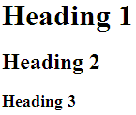
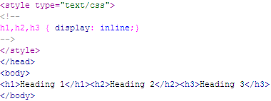

Example – display: inline;
Normally, the heading tags display in block format:
But, to have them display inline, add the style h1,h2,h3 {display: inline;}:

Slide 6
Reference
https://www.w3schools.com/cssref/pr_class_display.php

